Slide 1

Sai Srikar Lab-7

Slide 2
PANTONE® COLOUR OF THE YEAR 2022
import cv2
import numpy as np
from scipy import ndimage
import matplotlib.pyplot as plt
img = cv2.imread('picture.png')
gray = cv2.cvtColor(img, cv2.COLOR_BGR2GRAY)
img_gaussian = cv2.GaussianBlur(gray,(3,3),0)
#laplacian Edge
image = cv2.GaussianBlur(img, (3, 3), 0)
image_gray = cv2.cvtColor(image, cv2.COLOR_BGR2GRAY)
lap = cv2.Laplacian(image_gray, cv2.CV_16S, ksize=3)
abs_lap = cv2.convertScaleAbs(lap)
#canny
img_canny = cv2.Canny(img,100,200)
#sobel
img_sobelx = cv2.Sobel(img_gaussian,cv2.CV_8U,1,0,ksize=5)
img_sobely = cv2.Sobel(img_gaussian,cv2.CV_8U,0,1,ksize=5)
img_sobel = img_sobelx + img_sobely

Slide 3
PANTONE® COLOUR OF THE YEAR 2022
#prewitt
kernelx = np.array([[1,1,1],[0,0,0],[-1,-1,-1]])
kernely = np.array([[-1,0,1],[-1,0,1],[-1,0,1]])
img_prewittx = cv2.filter2D(img_gaussian, -1, kernelx)
img_prewitty = cv2.filter2D(img_gaussian, -1, kernely)
#robert
roberts_cross_v = np.array( [[1, 0 ],
[0,-1 ]] )
roberts_cross_h = np.array( [[ 0, 1 ],
[ -1, 0 ]] )
img_r= cv2.imread("picture.png",0).astype('float64')
img_r/=255.0
vertical = ndimage.convolve( img_r, roberts_cross_v )
horizontal = ndimage.convolve( img_r, roberts_cross_h )
edged_img = np.sqrt( np.square(horizontal) + np.square(vertical))
edged_img*=255

Slide 4
PANTONE® COLOUR OF THE YEAR 2022
cv2.imshow("Original Image", img)
cv2.waitKey(0)
cv2.destroyAllWindows()
cv2.imshow("Laplacian", abs_lap)
cv2.waitKey(0)
cv2.destroyAllWindows()
cv2.imshow("Canny", img_canny)
cv2.waitKey(0)
cv2.destroyAllWindows()
cv2.imshow("Sobel X", img_sobelx)
cv2.waitKey(0)
cv2.destroyAllWindows()
cv2.imshow("Sobel Y", img_sobely)
cv2.waitKey(0)
cv2.destroyAllWindows()
cv2.imshow("Sobel", img_sobel)
cv2.waitKey(0)
cv2.destroyAllWindows()
cv2.imshow("Prewitt X", img_prewittx)
cv2.waitKey(0)
cv2.destroyAllWindows()
cv2.imshow("Prewitt Y", img_prewitty)
cv2.waitKey(0)
cv2.destroyAllWindows()

Slide 5
PANTONE® COLOUR OF THE YEAR 2022
cv2.imshow("Prewitt", img_prewittx + img_prewitty)
cv2.waitKey(0)
cv2.destroyAllWindows()
cv2.imshow("Robert",edged_img)
cv2.waitKey(0)
cv2.destroyAllWindows()
plt.imshow(edged_img)
plt.title('Robert Edge')
plt.show()

Slide 6
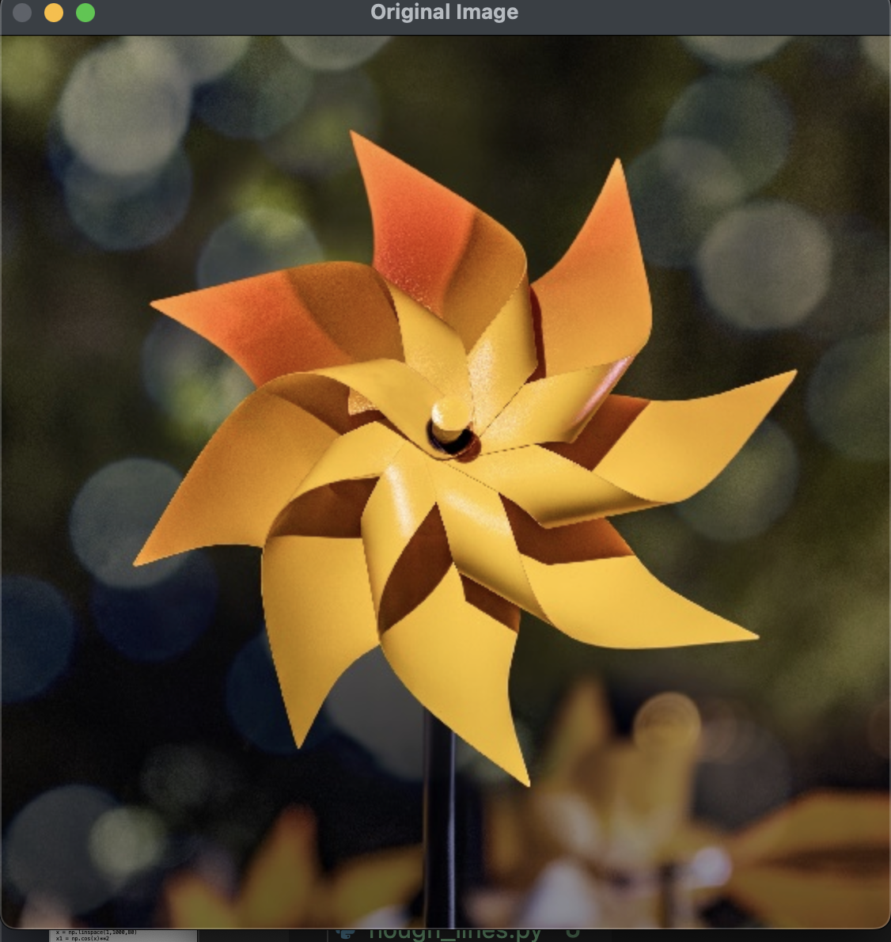
PANTONE® COLOUR OF THE YEAR 2022
OUTPUT-:

Slide 7
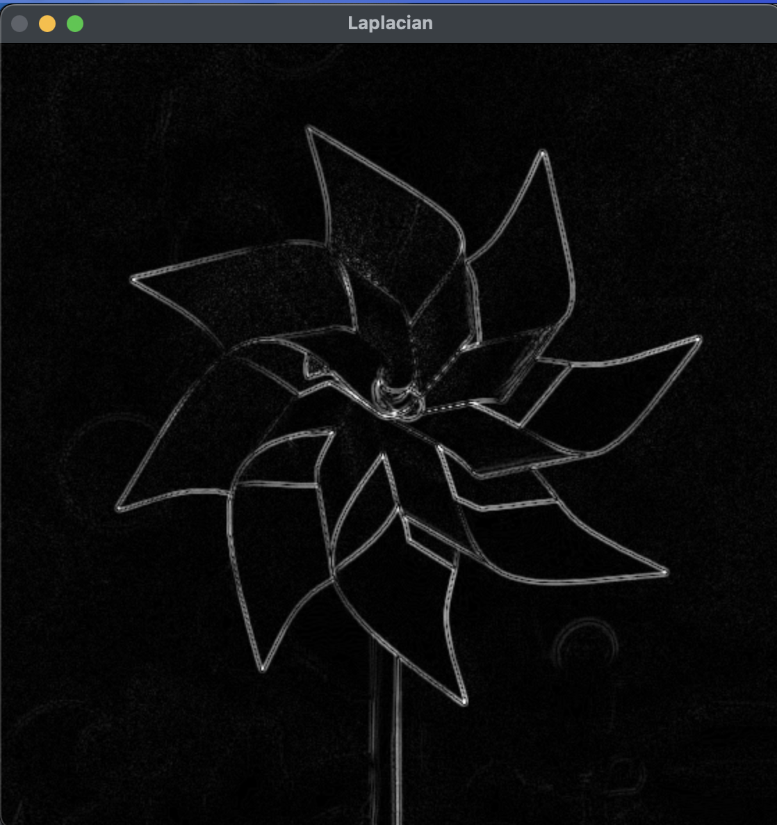
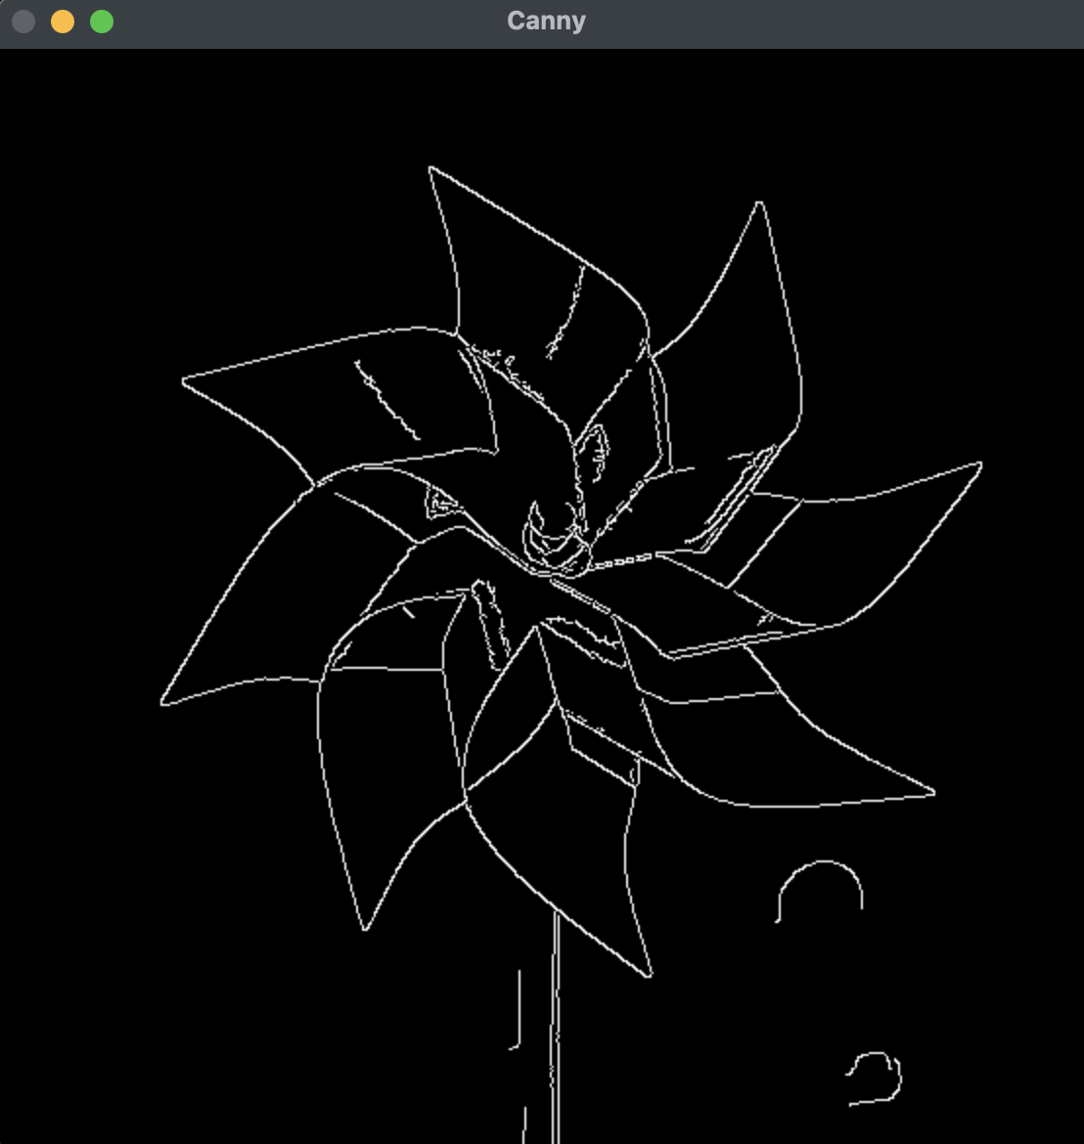
PANTONE® COLOUR OF THE YEAR 2022
OUTPUT-:

Slide 8
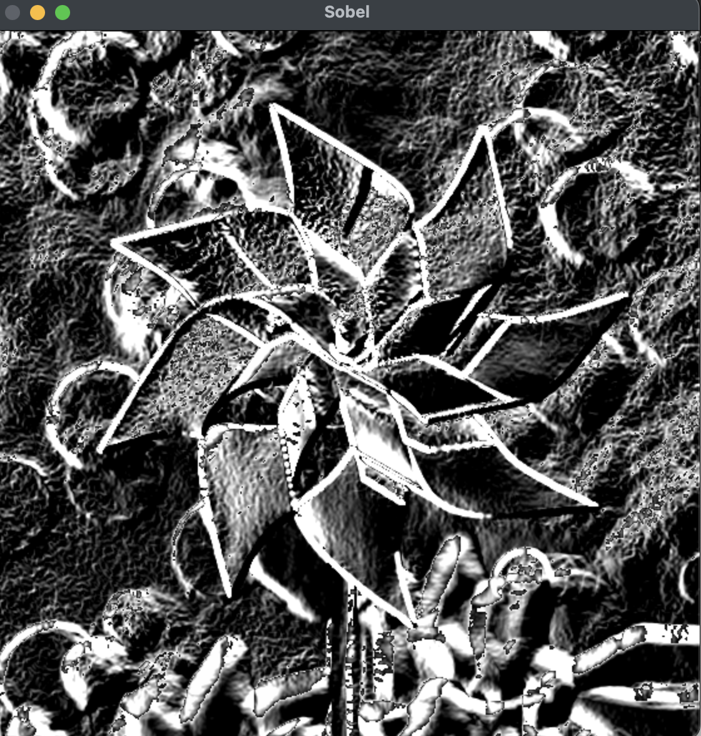
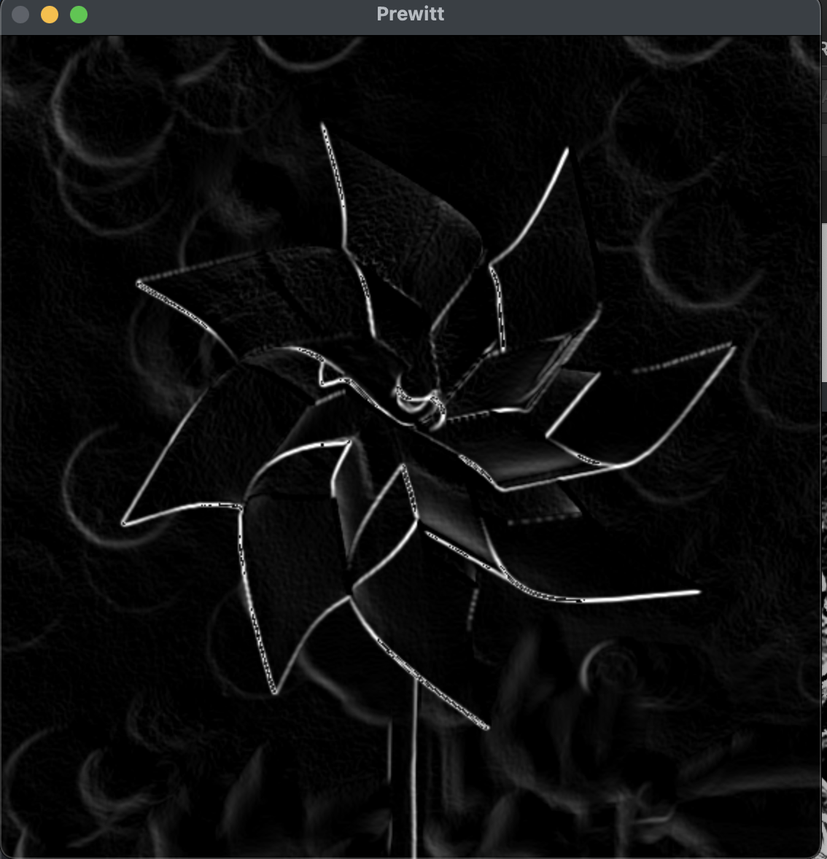
OUTPUT-:

Slide 9
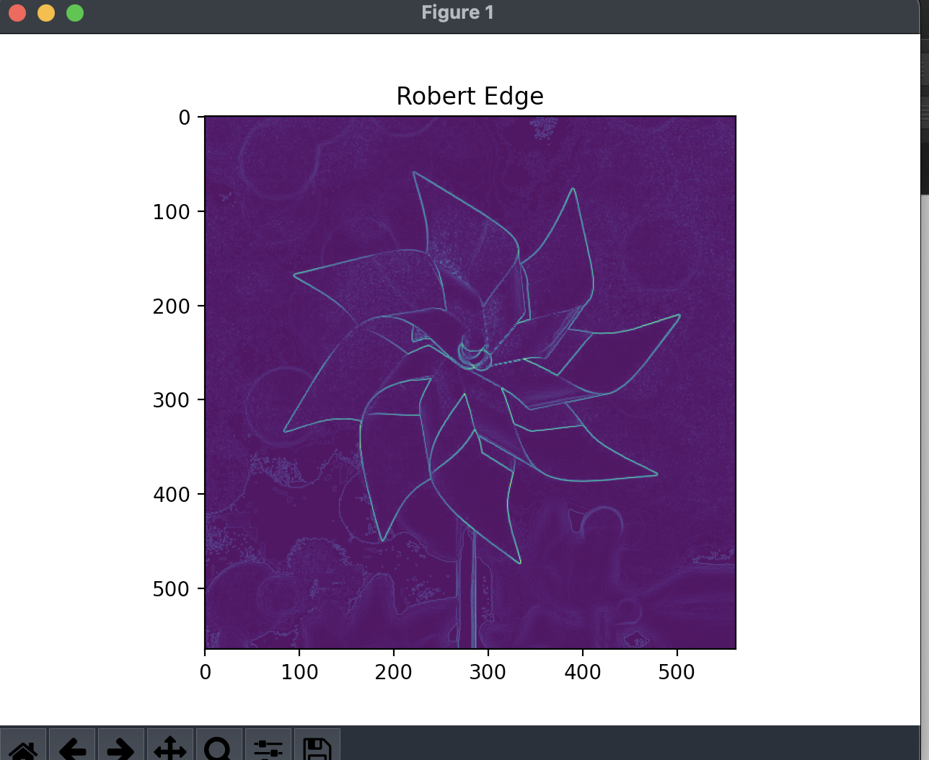
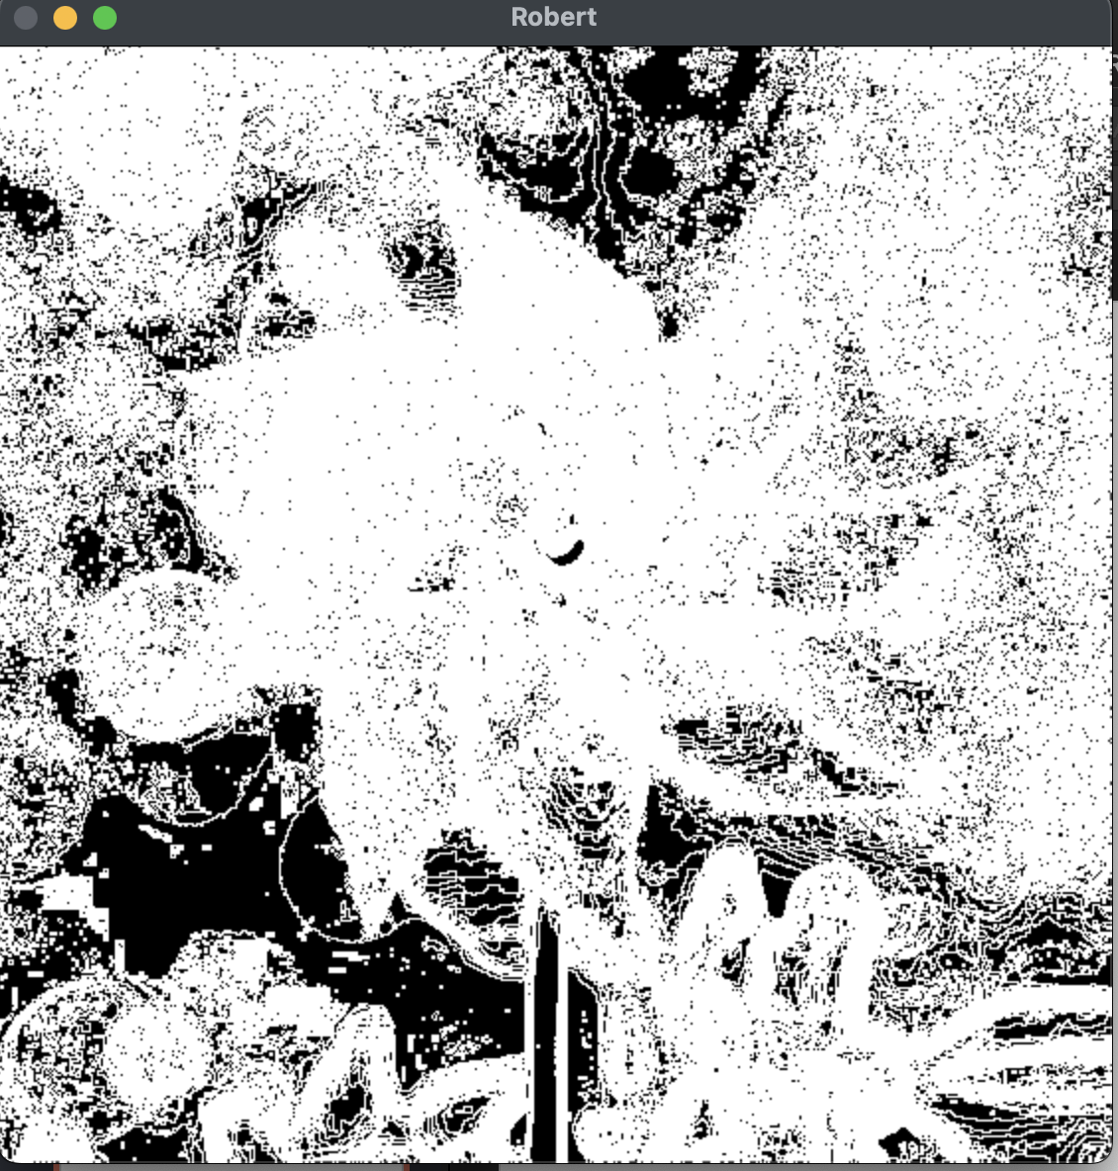
OUTPUT-:

Slide 10
import cv2
import numpy as np
import matplotlib.pyplot as plt
image = cv2.imread("butterfly.jpeg")
cv2.imshow("Original Image",image)
gray = cv2.cvtColor(image,cv2.COLOR_BGR2GRAY)
edges = cv2.Canny(gray,50,150,apertureSize=3)
lines_list =[]
lines = cv2.HoughLinesP(
edges,
1,
np.pi/180,
threshold=100,
minLineLength=5,
maxLineGap=10
)

Slide 11
for points in lines:
x1,y1,x2,y2=points[0]
cv2.line(image,(x1,y1),(x2,y2),(0,255,0),2)
lines_list.append([(x1,y1),(x2,y2)])
plt.imshow(image)
plt.title('Line detection')
plt.show()

Slide 12
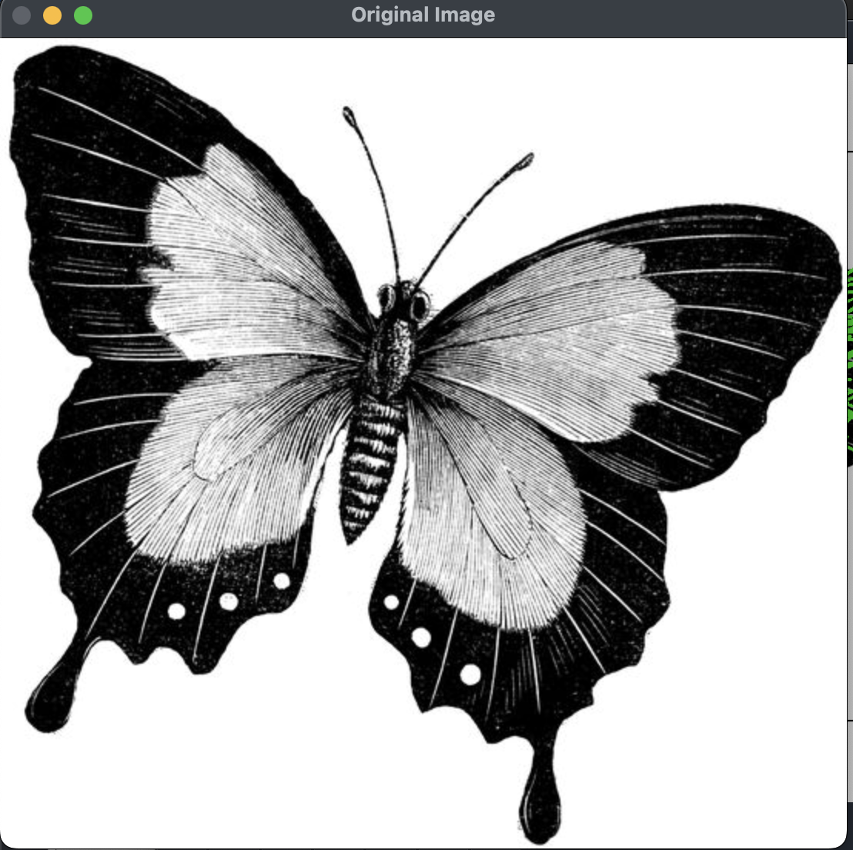
PANTON® COLOUR OF THE YEAR 2022
OUTPUT-:

Slide 13
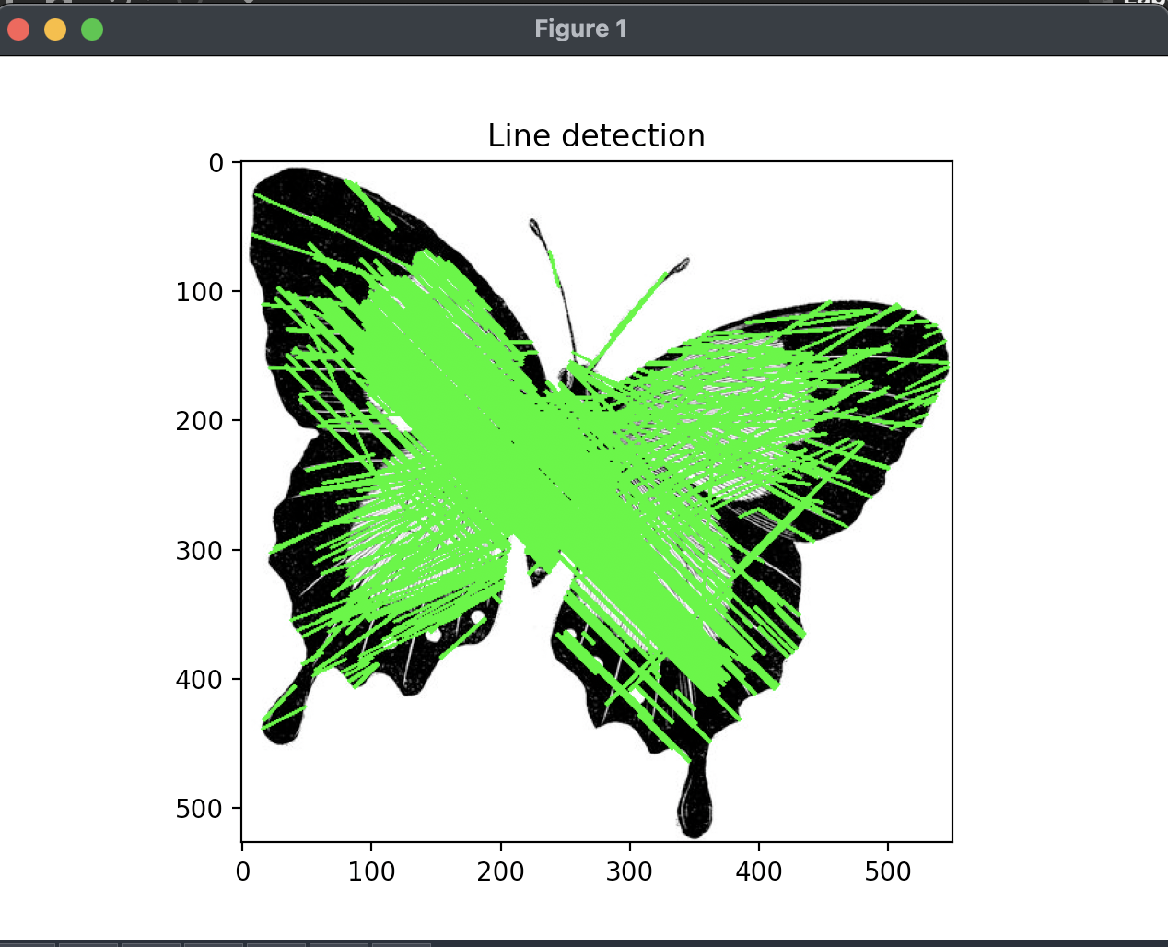
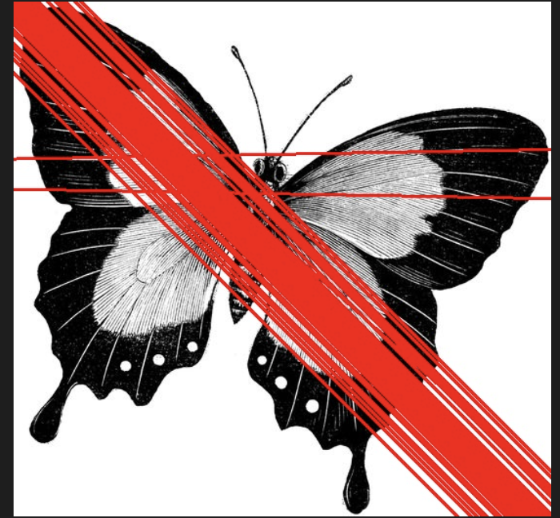
PANTON® COLOUR OF THE YEAR 2022
OUTPUT-:

Slide 14
PANTONE® COLOUR OF THE YEAR 2022
import sys
import cv2 as cv
import numpy as np
src = cv.imread("/Users/apple/Desktop/code/Digital_Image_processing/butterfly.jpeg")
gray = cv.cvtColor(src, cv.COLOR_BGR2GRAY)
gray = cv.medianBlur(gray, 5)
rows = gray.shape[0]
circles = cv.HoughCircles(gray, cv.HOUGH_GRADIENT, 1, rows / 8, param1=100, param2=30,minRadius=1, maxRadius=30)
if circles is not None:
circles = np.uint16(np.around(circles))
for i in circles[0, :]:
center = (i[0], i[1])
# circle center
cv.circle(src, center, 1, (0, 100, 100), 3)
# circle outline
radius = i[2]
cv.circle(src, center, radius, (255, 0, 255), 3)
cv.imshow("detected circles", src)
cv.waitKey(0)

Slide 15
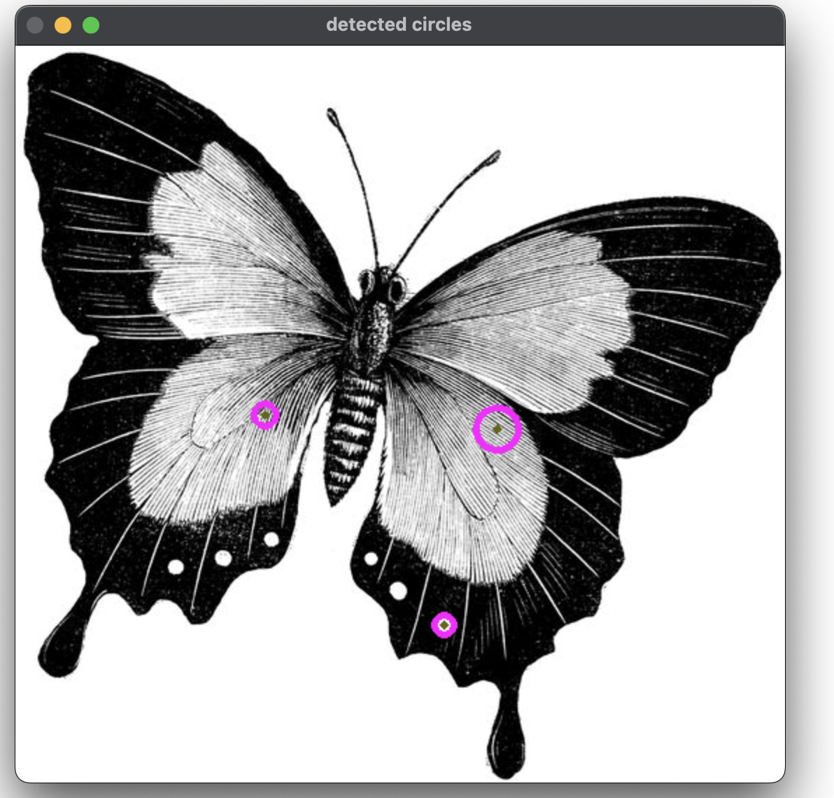
OUTPUT-:

Slide 16
PANTONE® COLOUR OF THE YEAR 2022
CODE-2
import numpy as np
import cv2
import matplotlib.pyplot as plt
img = cv2.imread("butterfly.jpeg",0)
img = cv2.medianBlur(img,5)
cimg = cv2.cvtColor(img,cv2.COLOR_GRAY2BGR)
circles = cv2.HoughCircles(img,cv2.HOUGH_GRADIENT,1,20,
param1=50,param2=30,minRadius=0,maxRadius=0)
circles = np.uint16(np.around(circles))
for i in circles[0,:]:
cv2.circle(cimg,(i[0],i[1]),i[2],(0,255,0),2)
cv2.circle(cimg,(i[0],i[1]),2,(0,0,255),3)
plt.imshow(cimg)
plt.title('Circle detection')
plt.show()

Slide 17
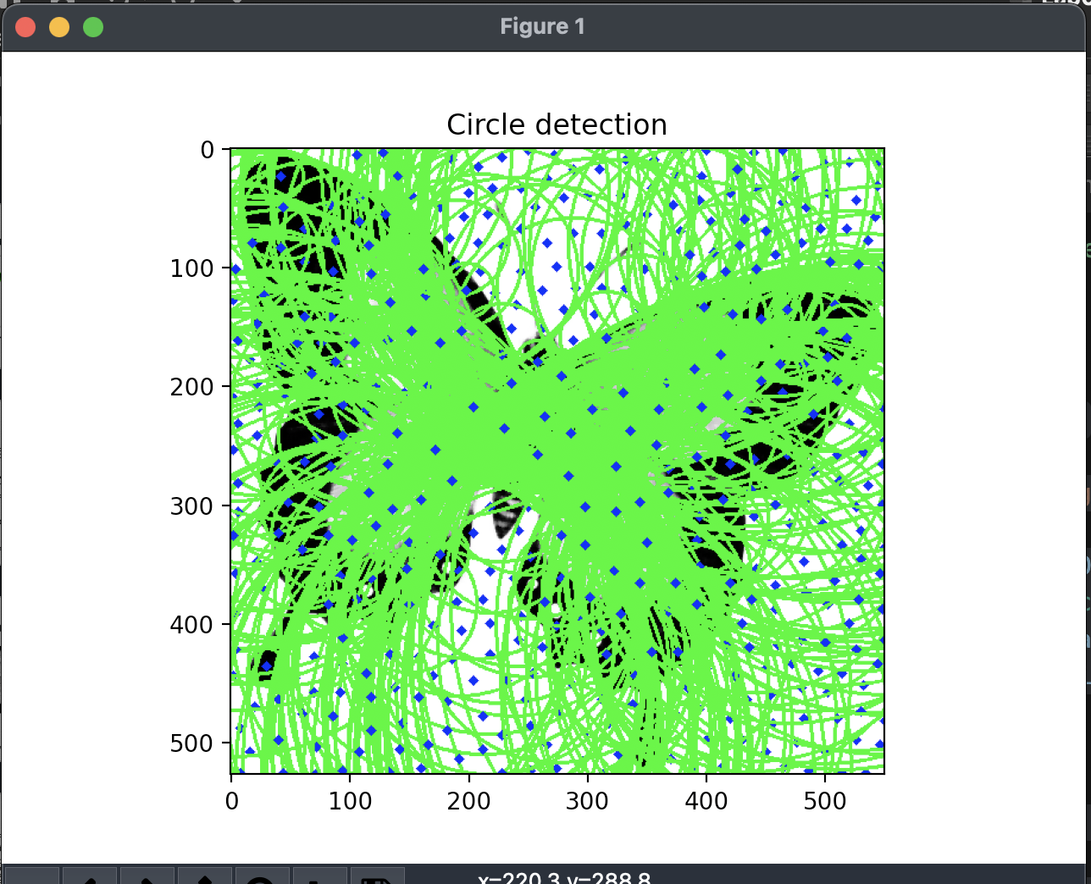
OUTPUT-:

Slide 18
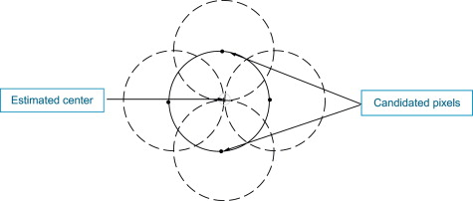
PANTONE® COLOUR OF THE YEAR 2022
APPLICATIONS OF HOUGH TRANSFORMATIONS-:
The Hough transform is a popular feature extraction technique that converts an image from Cartesian to polar coordinates. Any point within the image space is represented by a sinusoidal curve in the Hough space. In addition, two points in a line segment generate two curves, which are overlaid at a location that corresponds with a line through the image space. Even though this model form is very easy, it is deeply complicated for the case of complex shapes due to noise and shape imperfection, as well as the problem of finding slopes of vertical lines. The CHT solved this problem by putting a transformation of the centroid of the shape in the x-y plane to the parameter space

Slide 19
THANK YOU You can find the code at -: https://github.com/Baka-14/Digital_Image_processing

